Slide 1

B04 Om Sanjay Phatak [1920000033] B07 Pratham Mohan Patil [1920000074] B08 Vinayak Prakash Mali [1920000078]
Kolhapur Institute of Technology’s College of Engineering, Kolhapur
(An Autonomous Institute Accredited ‘A’ grade by NAAC with CGPA 3.12)
Department of Computer Science & Engineering
Advanced Database System PBL
GROUP 06

Slide 2
TRIP MANAGEMENT SYSTEM

Slide 3
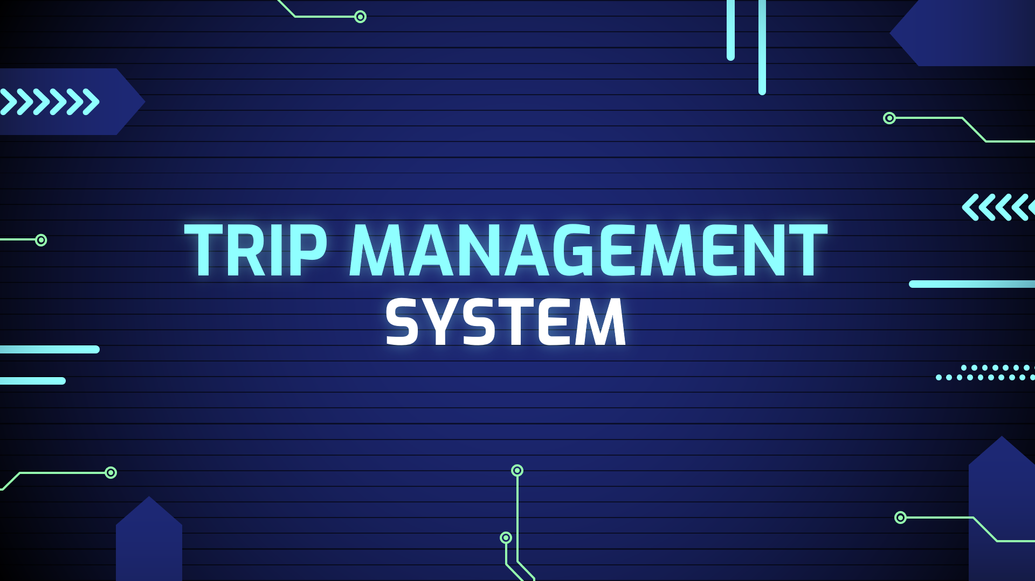
PROBLEM STATEMENT
To design and implement a database for Trip Management System.

Slide 4
PURPOSE
In today’s era, everyone wants convenience and comfort in daily life activities but everywhere it is not possible. Travelling is also a major part of day-to-day activities and in the same case, people want the same comfort assistance throughout the whole journey. The objective of the ‘Trip Management System’ is to automate vehicle rental and reservation. So, customers do not need to call & spend unnecessary time in order to reserve their preferred vehicle. It is a web application that lets you book taxis for inter-city and intra-city travel purposes using your login credentials and provides you the best service that will make your journey more luxurious. The users will be provided with a provision login to the systems so they can check the status of their journey. The taxi driver will be provided with a provision login to the system. So, they can check reservations, update their availability status, and also, they can see their daily, monthly, and yearly fair earnings.

Slide 5
SCOPE
This project’s aim is to automate the system, calculating the fare, collecting fare, collecting all necessary information of the client, and then serving the client. The data used by the system is stored in a database that will be the centre of all information held by clients and employees and the base for the remainder of the process after the initial application has been made. This enables things to be simplified and considerably quickened, making the jobs of the people involved easier. It supports the current process but centralizes it and makes it possible for decisions to be made earlier and easier way.

Slide 6
GOALS
Manage a large number of client details.
Manage all details of clients who registered and requested for getting the service.
Create employee accounts and maintain the data effectively.
View all the details of the clients and employees (drivers).
Showing available vehicles to book for the client.
Calculating and showing the fare to the client before booking.
Create statistical reports to facilitate the finance department’s work.
Getting a rating from the client to facilitate a reward facility.

Slide 7
PRODUCT PERSPECTIVE
{ Let’s understand the working flow }

Slide 8
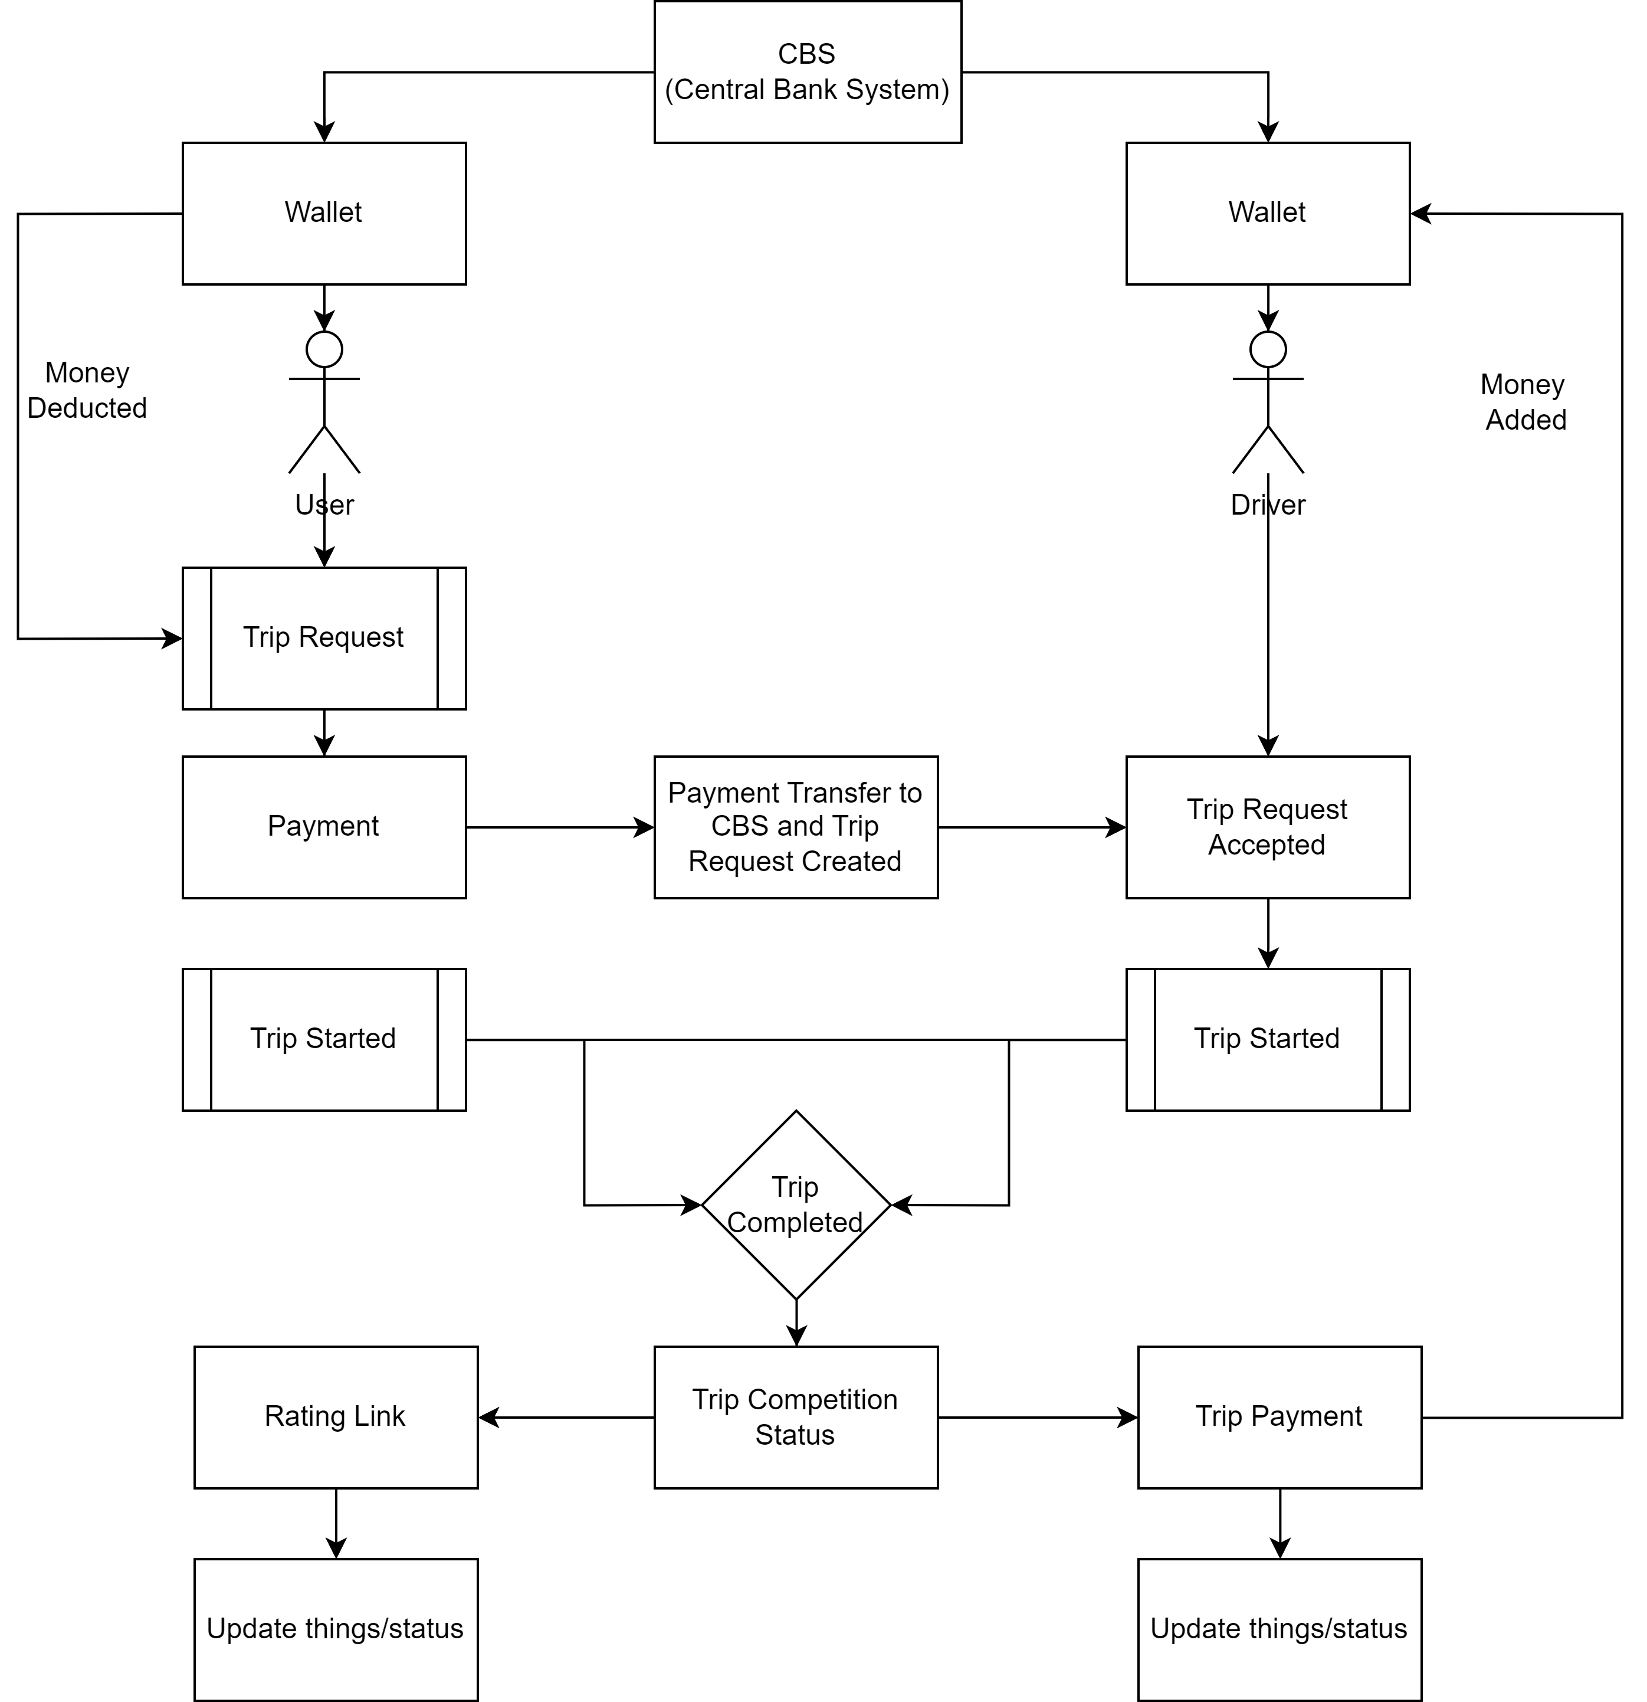
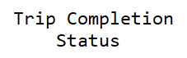

Slide 9
FUNCTIONAL REQUIREMENTS
Administrator Aspect:
Perform weekly roster of Employees
Print reports annually, weekly, and daily
Check ratings
View user portfolio
Changing the super password.
Employee Aspect:
Logging into the system.
To check their rosters.
Maintain daily logs
Select availability.
Check online bookings
Withdraw money from CBS to the driver’s wallet
Client Aspect:
Add money from CBS to the client’s wallet
Make a booking
Check their booking status
Fair calculation
Trip history
Give a rating to a trip
Analysis:
Authenticating users based on username and password.
Keeping session track of user activity.
Add money from CBS to the wallet
Recording client’s request for booking.
Booked trip payment transfer to CBS
Booked trips are shown to the driver.
Payment transfer from CBS to driver’s wallet
Keeping a history of trip bookings.
Keeping a record of ratings received from the clients.

Slide 10
NON-FUNCTIONAL REQUIREMENTS
Security Requirements:
Some of the factors that are identified to protect the software from accidental or malicious access, use, modification, destruction, or disclosure are described below. Specific requirements in this area could include the need to: Utilize certain cryptographic techniques Keep a specific log or history of data sets, assign certain functions to different modules, restrict communications between some areas of the program, and check data integrity for critical variables. Later, the version of the software will incorporate encryption techniques in the user/license authentication process. The software will include an error-tracking log that will help the user understand what error occurred when the application crashed along with suggestions on how to prevent the error from occurring again. Communication needs to be restricted when the application is validating the user or license. (i.e., using https).
Portability Requirements:
Some of the attributes of software that relate to the ease of porting the software to other host machines and/or operating systems. This may include: Apache is used to develop the product. So, it is easiest to port the software in any environment.

Slide 11
TECHNOLOGIES
JavaScript scripting for server-side scripting as it has a very strong support for XML and Oracle Express Edition.
XML as database format: The database’s performance requirements are not very high and the ability to have custom fields in case the application form needs to add more than the expected requirement. This is limited in any other database management system where we have to first specify the maximum number of fields.

Slide 12
CASE DIAGRAMS

Slide 13
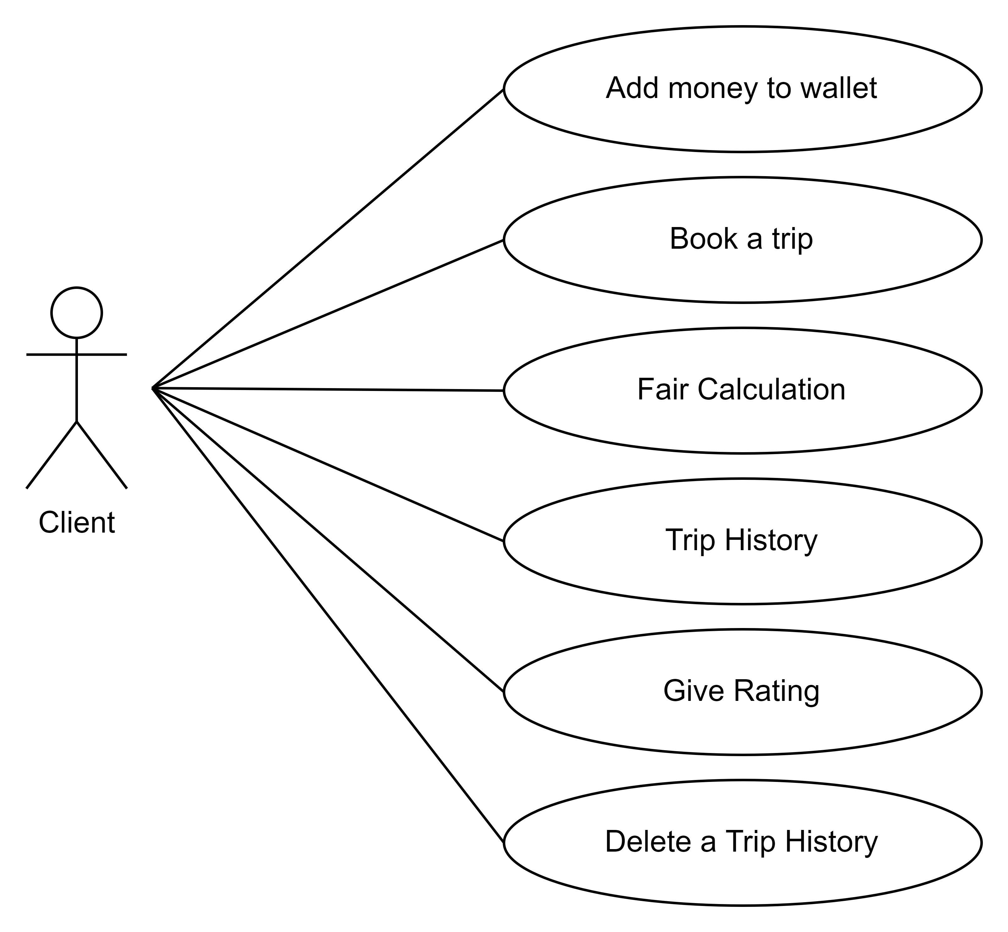
CUSTOMER (CLIENT)

Slide 14
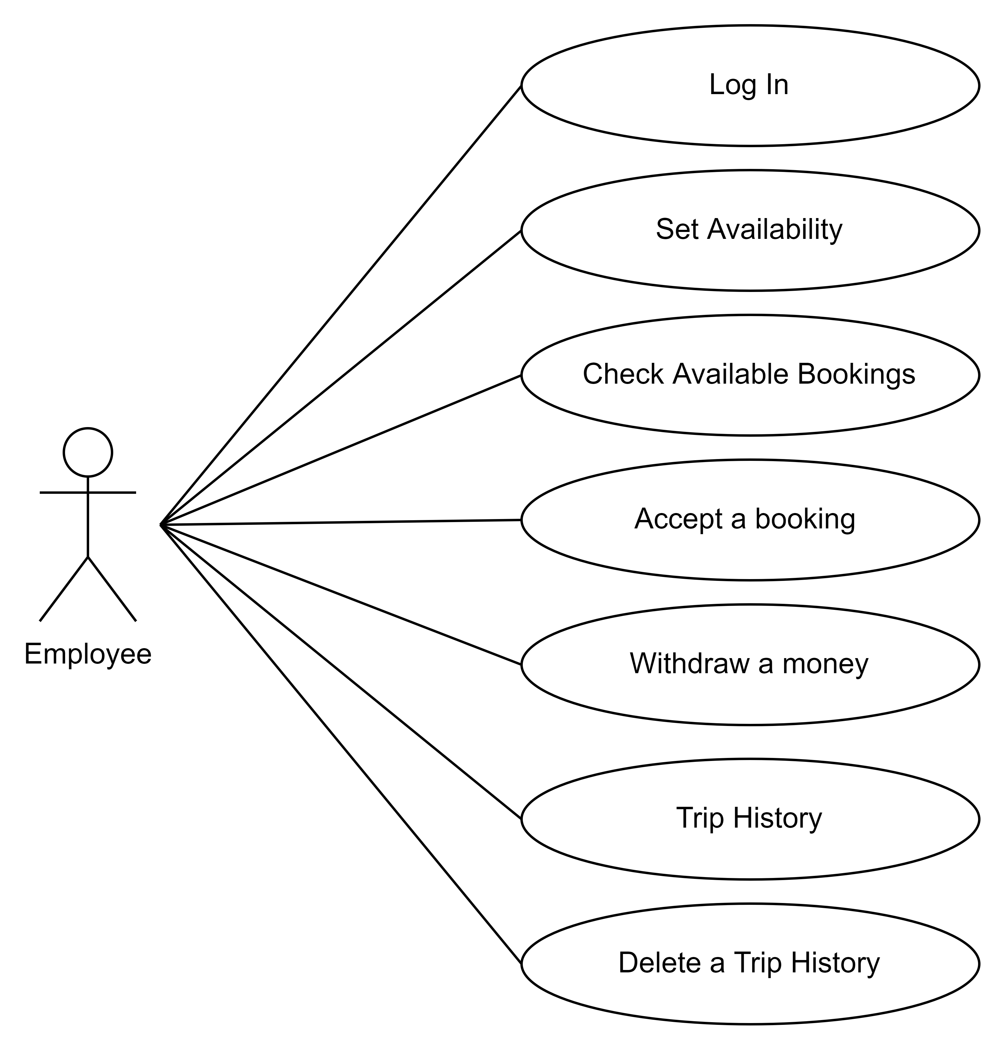
EMPLOYEE (DRIVER)

Slide 15
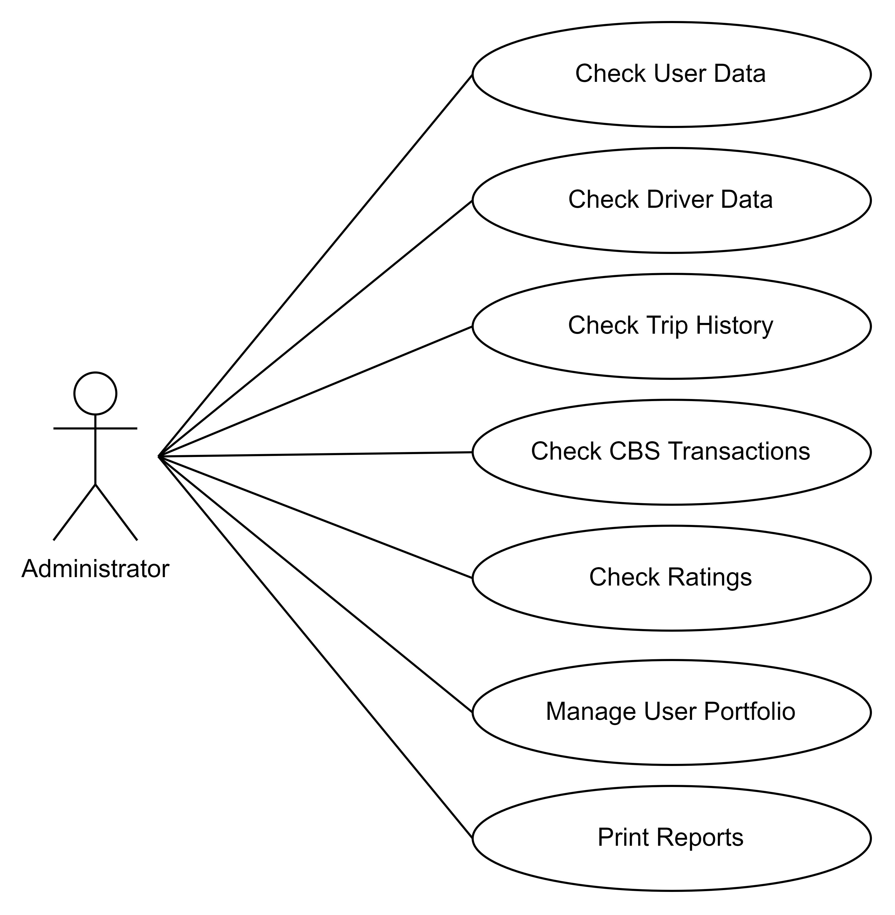
ADMINISTRATOR

Slide 16

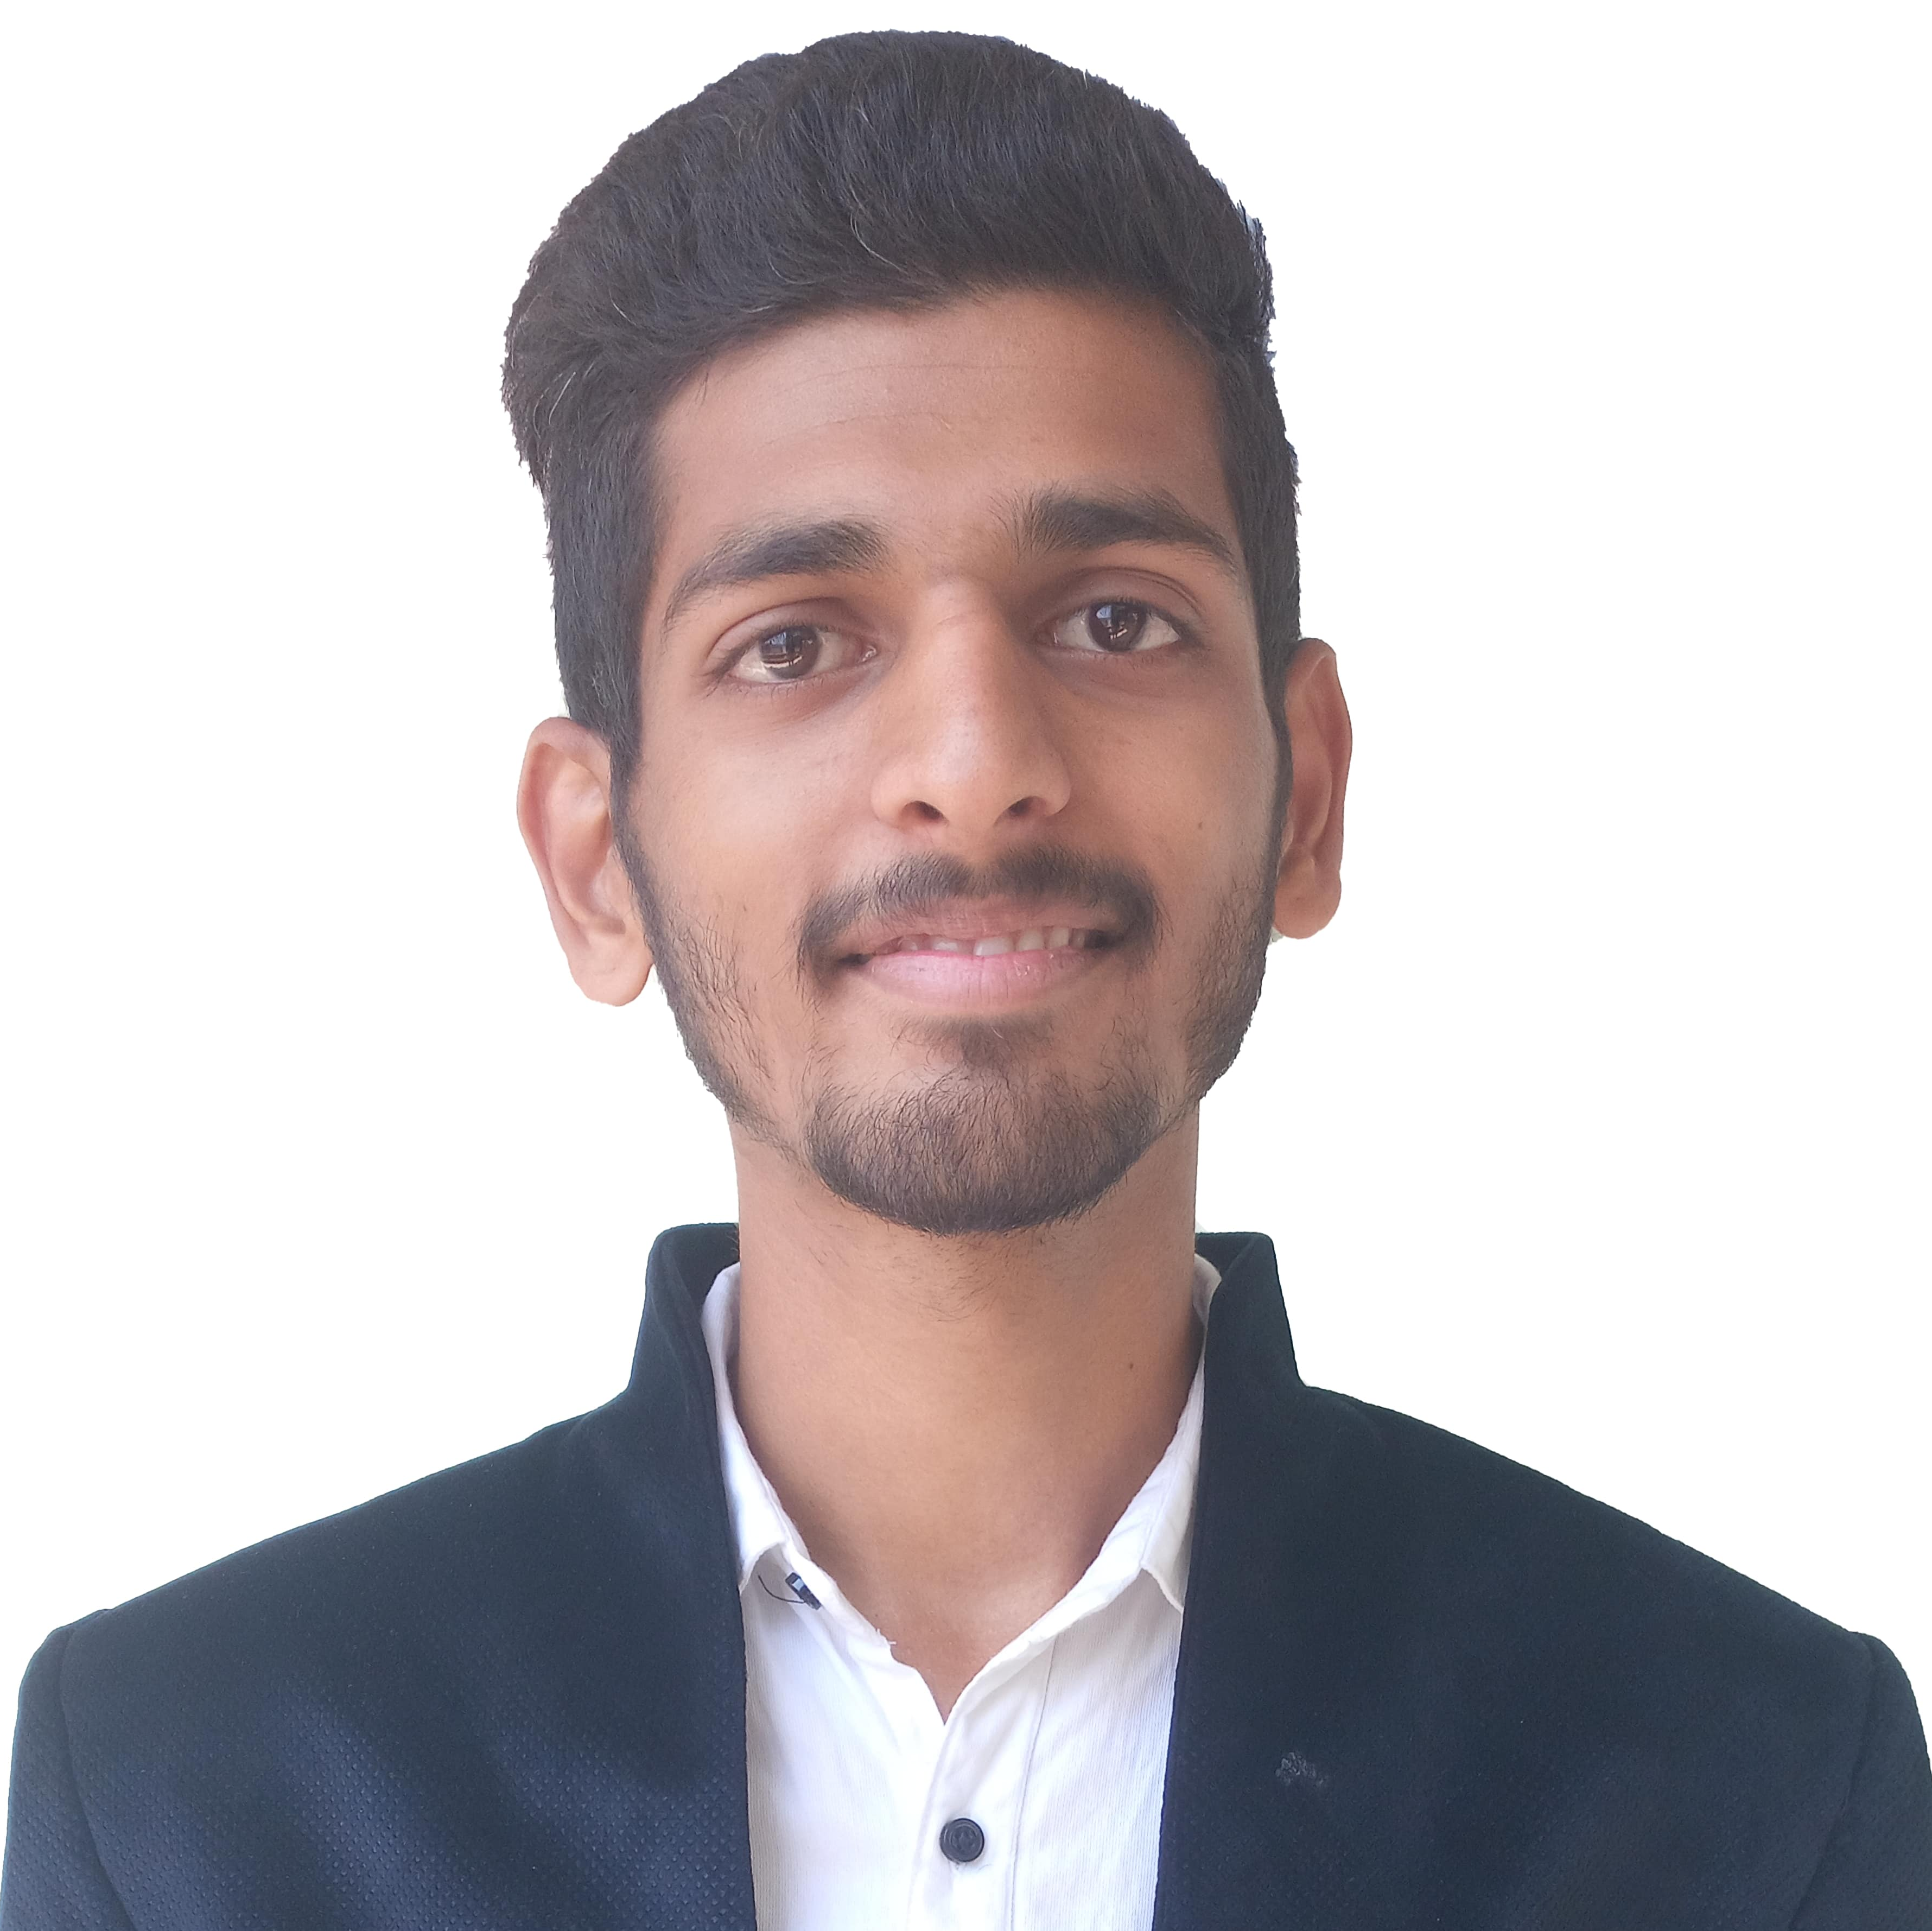
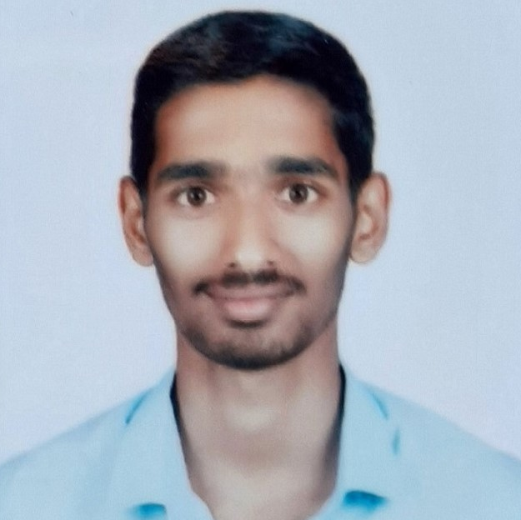
OUR TEAM
Om Phatak
Pratham Patil
Vinayak Mali
1920000033
1920000074
1920000078

Slide 17
THANK YOU!

